Slide 1

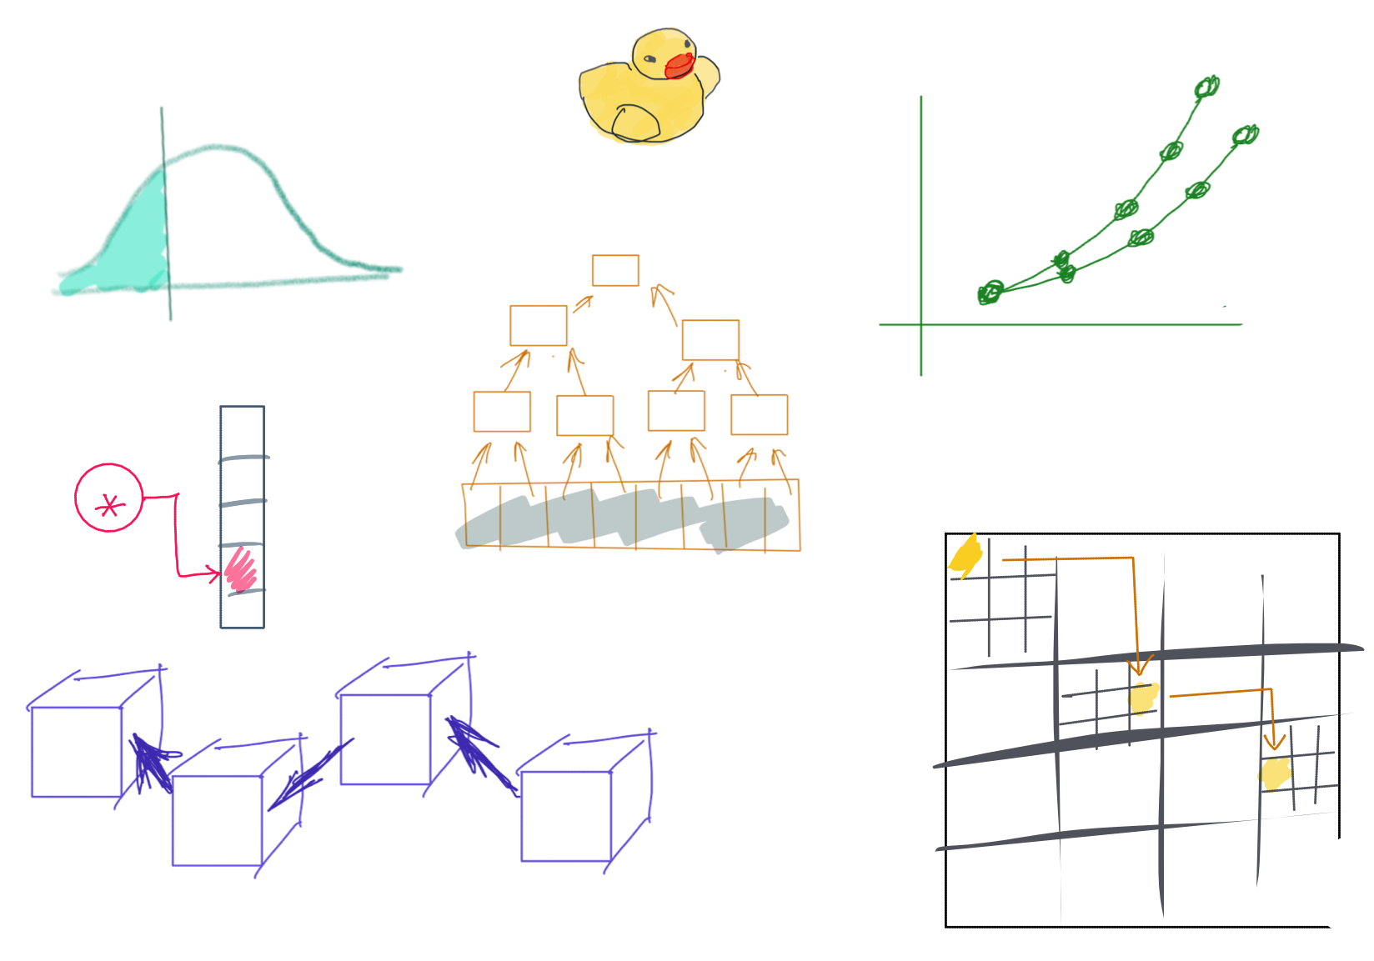

Slide 2

BootUp – C++

Slide 3

Lecturer
Peng Du
High performance computing
Matrix stuff, Matrix Factorization, etc
Cloud & Edge computing
Kubernetes, docker, etc.
Part-time Teaching
CSS 342
CSS 143

Slide 4
Course Evaluation
https://forms.gle/Vy4ZsbcDUyZ1PBDD6
pengdu@uw.edu

Slide 5

Agenda
Prelude: Tooling
Source code management
Build
Debug
ACT I: Basics
Variable
Pointer, reference
Array
Control flow (loop, if)
Function
ACT II: Memory Management
Heap vs stack memory
new & delete
Memory leak
Bad reference
ACT III: Object Oriented Programming
class
Object/instance
Inheritance
Metamorphism

Slide 6
Prelude: Tooling
Source code management
Build
Debug

Slide 7

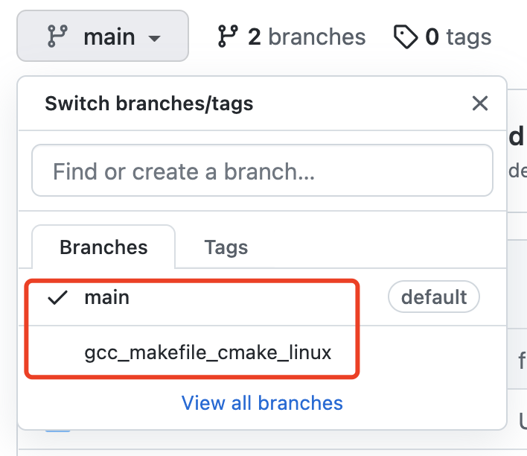
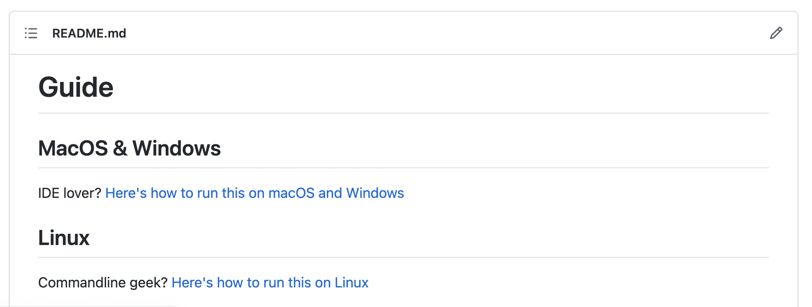
Code
https://github.com/a-teaching-goose/uwb-bootup
https://github.com/a-teaching-goose/2022-bootup#readme
Usage instruction
Two branches, one for IDE and one for command line

Slide 8
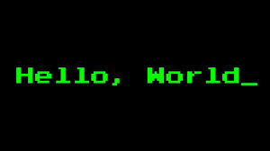
Code Demo

Slide 9
The Dev Environment

Slide 10
Tooling
OS:
Windows, Linux, Mac
IDE/Editor:
Visual studio, VS Code, Clion, Xcode, Atom, etc.
VIM, Emacs
Makefile, CMake
Online Editor
Testing:
A review by Clion
Googletest
Source Control
Git, www.github.com

Slide 11
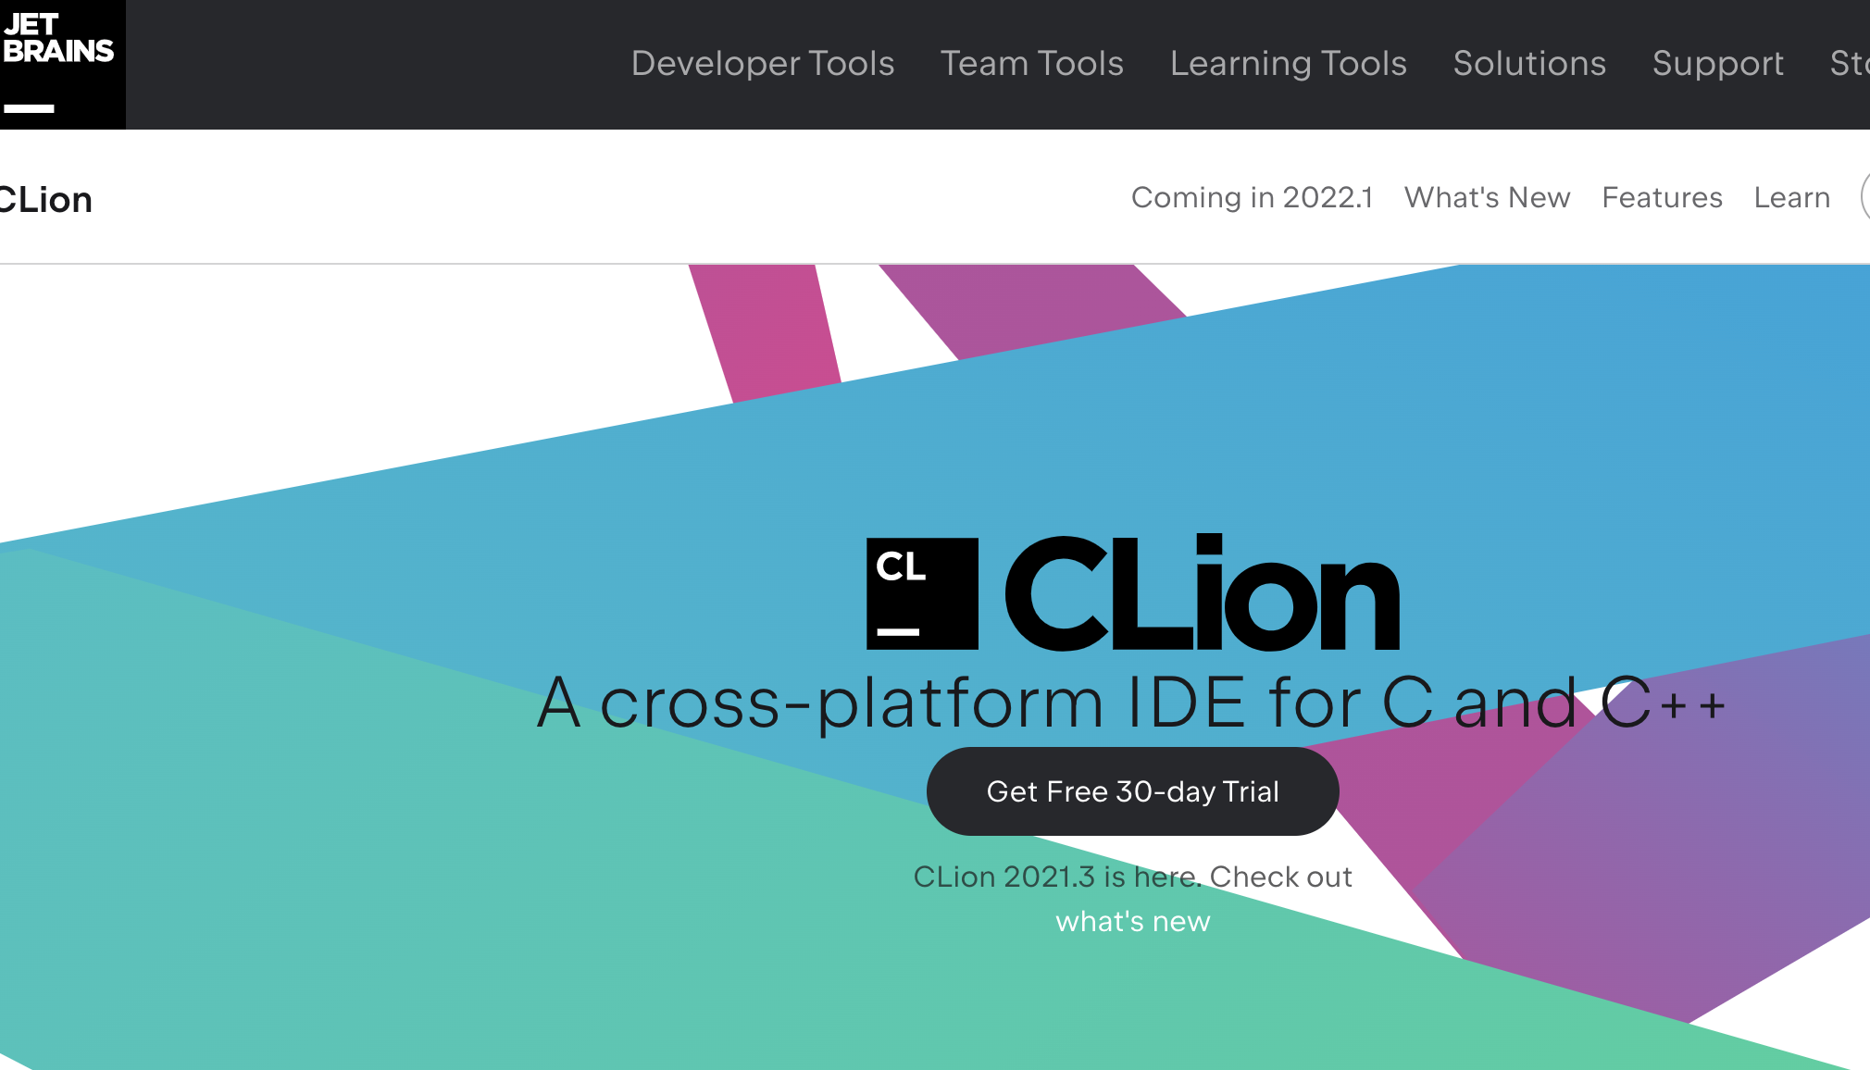

Editor: IDE
It’s Free!
https://www.jetbrains.com/clion/
https://www.jetbrains.com/community/education/#students

Slide 12

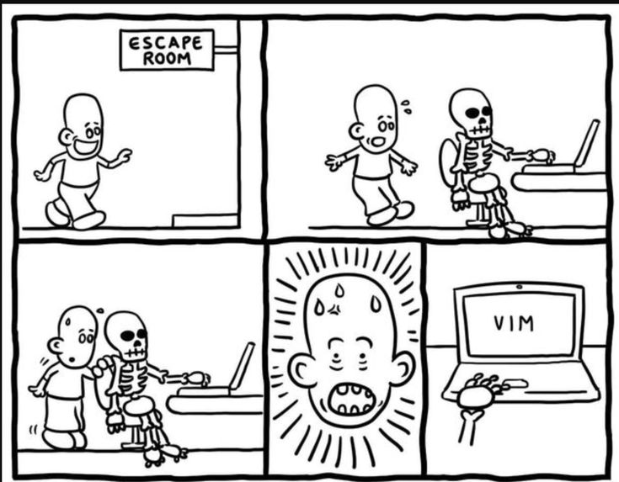
Editor: Vim (Linux)
Available on (pretty much) all OS
Website in 80s, but probably the best editor you’ll have in your life
So many jokes about people not knowing how to exit from Vim

Slide 13

Source Control
“My laptop crashed last night, and my homework is gone”
How do you safely store your code and track changes?

Slide 14
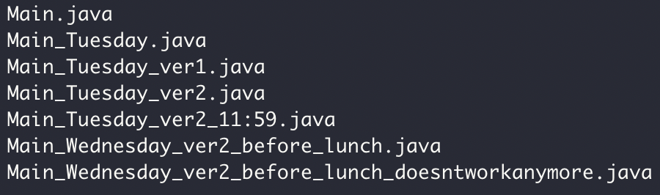

Source Control

Slide 15

Why Git and GitHub
Widely used in industry and open source projects
Easy to track progress (commits)
Easy to track features (branch)
Easy to collaborate with others (GitHub)
Example: https://github.com/futurewei-cloud/chogori-platform

Slide 16


Source Control
Code version 1
Code version 2
Code version 3
“commits”
Code version 1
Code version 2
Code version 3
Code
……
Your computer
Monday
Tuesday
Wednesday
Thursday

Slide 17



Git/GitHub Terms
Repository, or “Repo”
Collection files from a project
Commit
A snapshot of the repo at the certain time
Branch
A line of development, consisting of a series of commits

Slide 18
Source Control: Branch
Commit 1
Commit 2
Commit 3
Commit 6
Merge, Commit 7
The Main branch
another branch
Commit 4
Commit 5

Slide 19



Push
Pull

Slide 20
Pull
Push

Slide 21
Homework repo
Exact Mirror
Homework repo

Slide 22
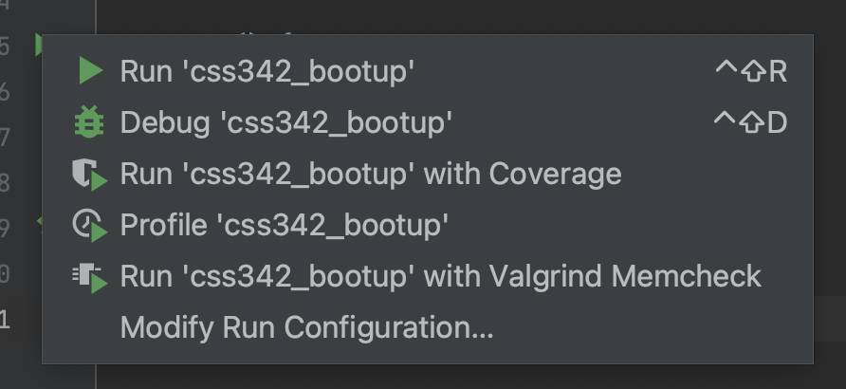
Code -> Binary
What happens when you click

Slide 23
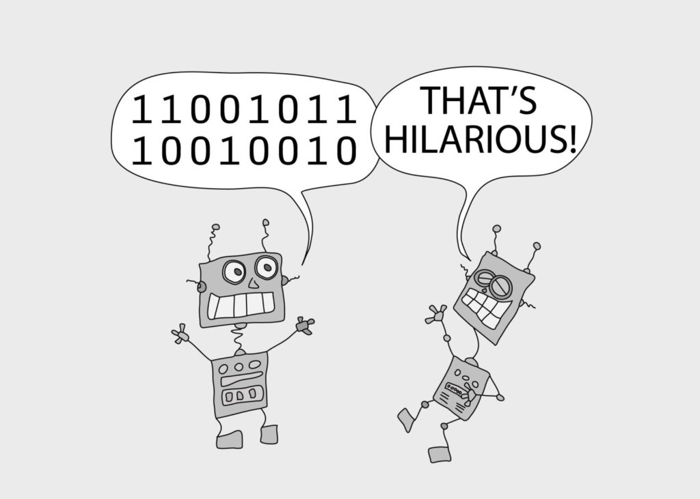
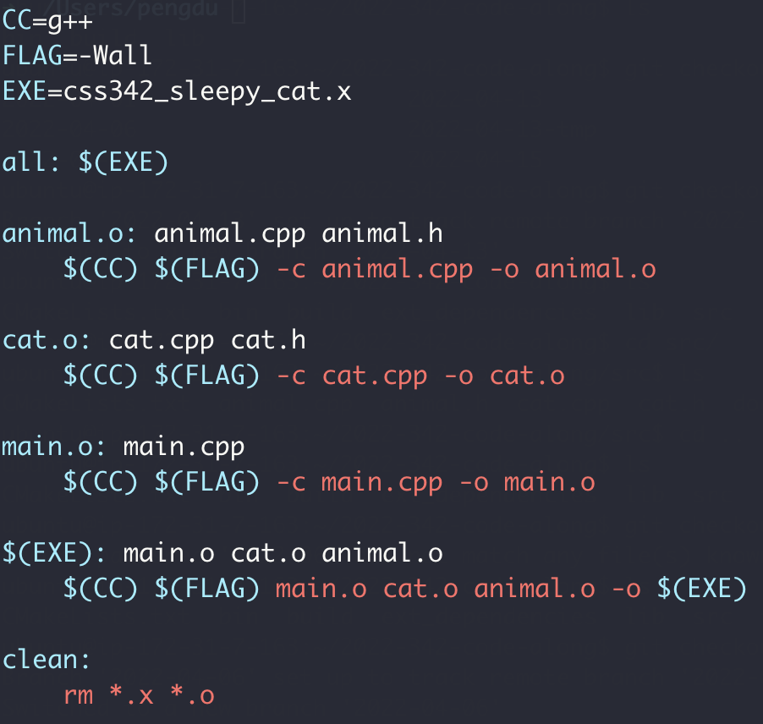
Makefile

Slide 24
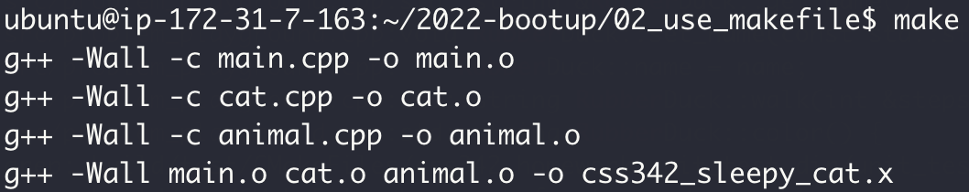
Makefile

Slide 25
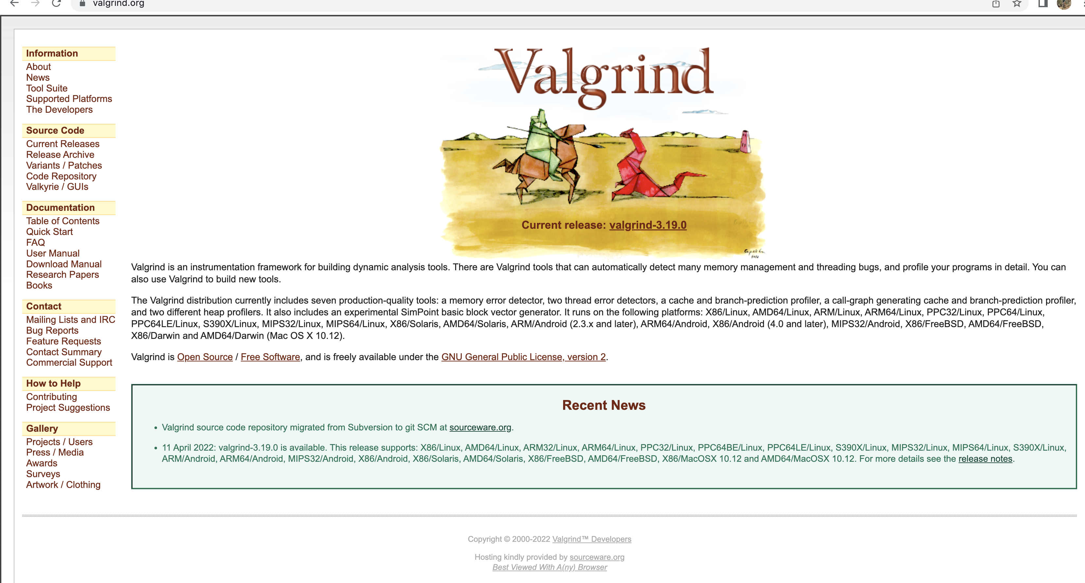
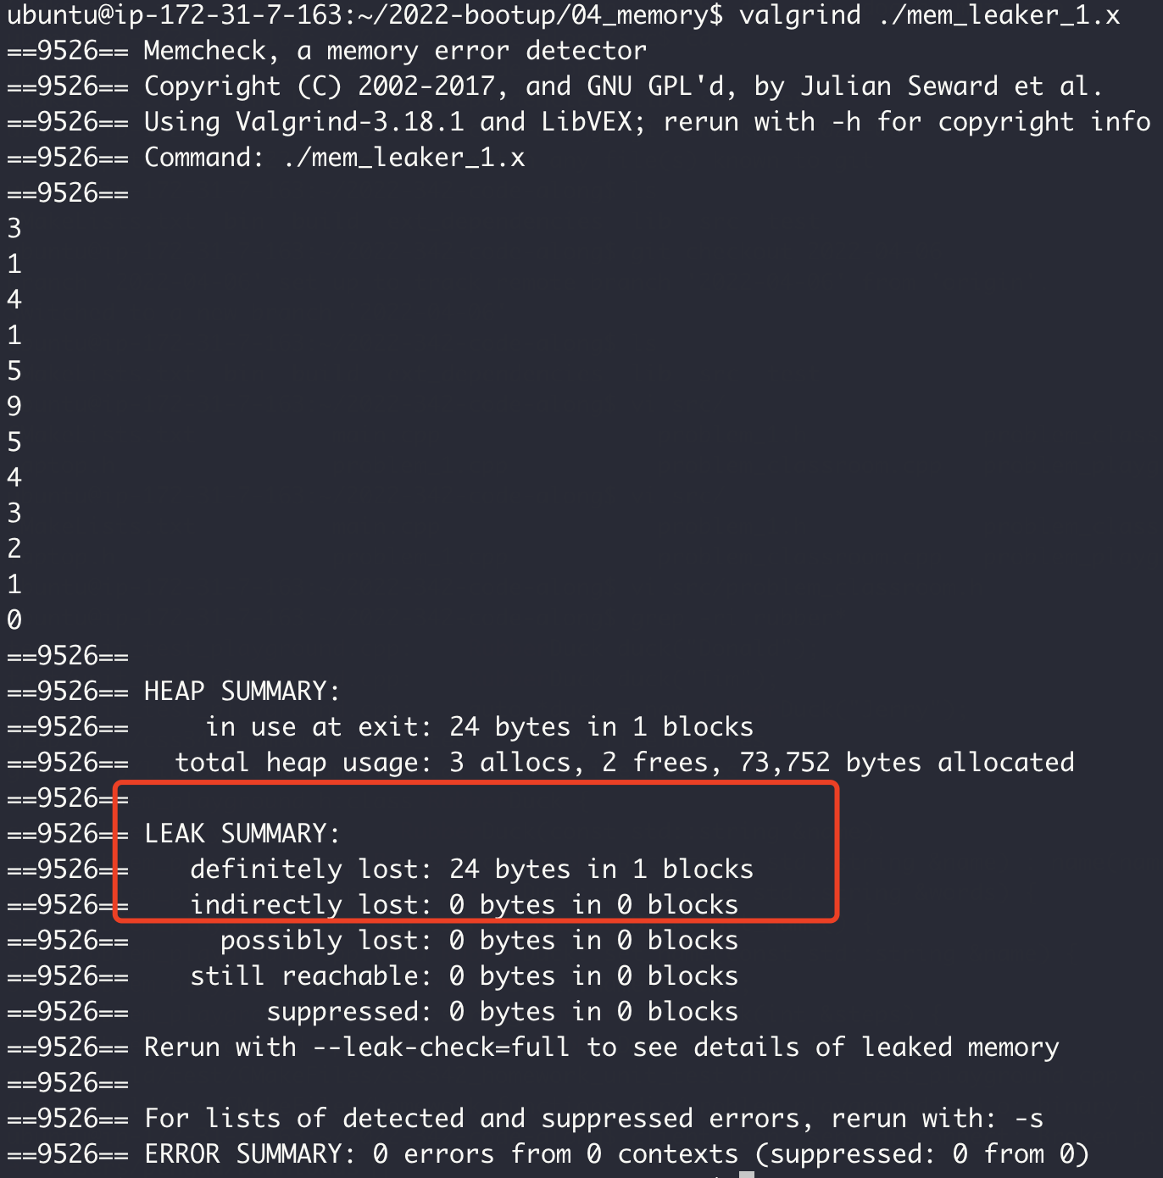
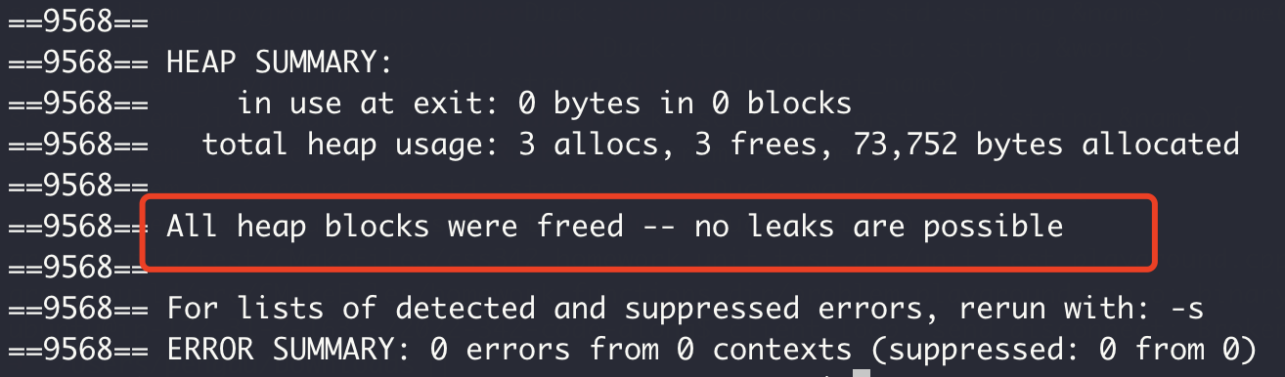
Memory Checker

Slide 26
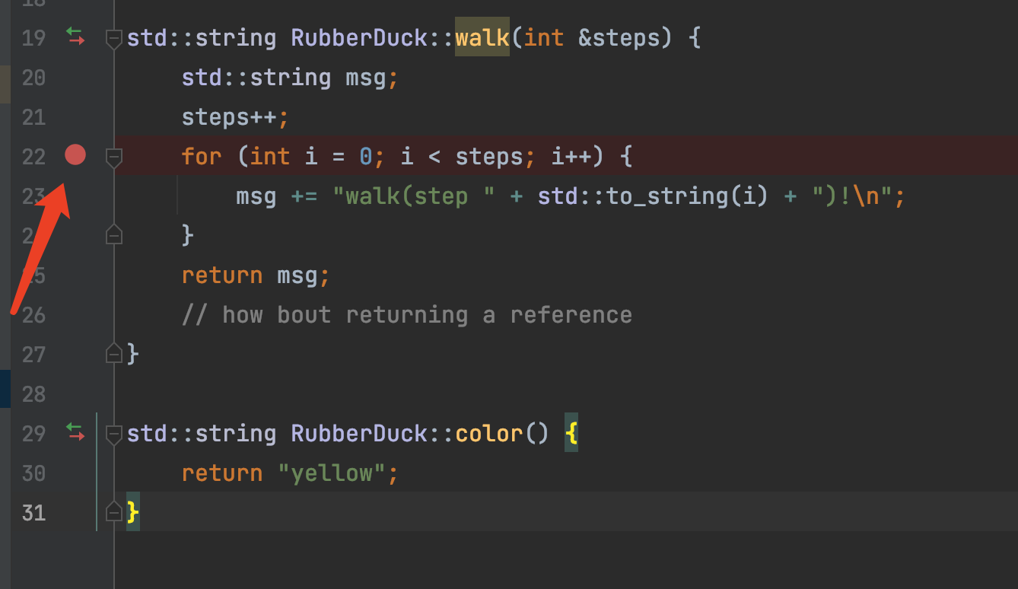
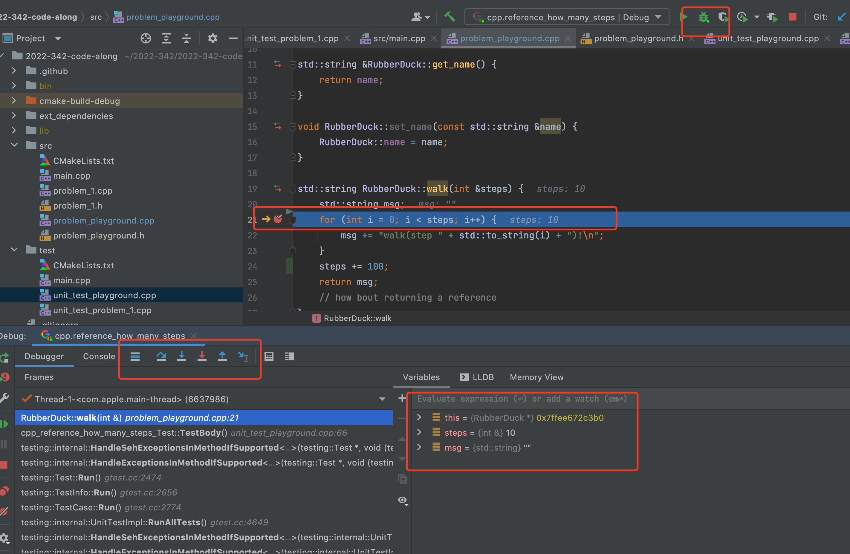
Debugging
Breakpoint
Step in
Step over
Read Variable

Slide 27
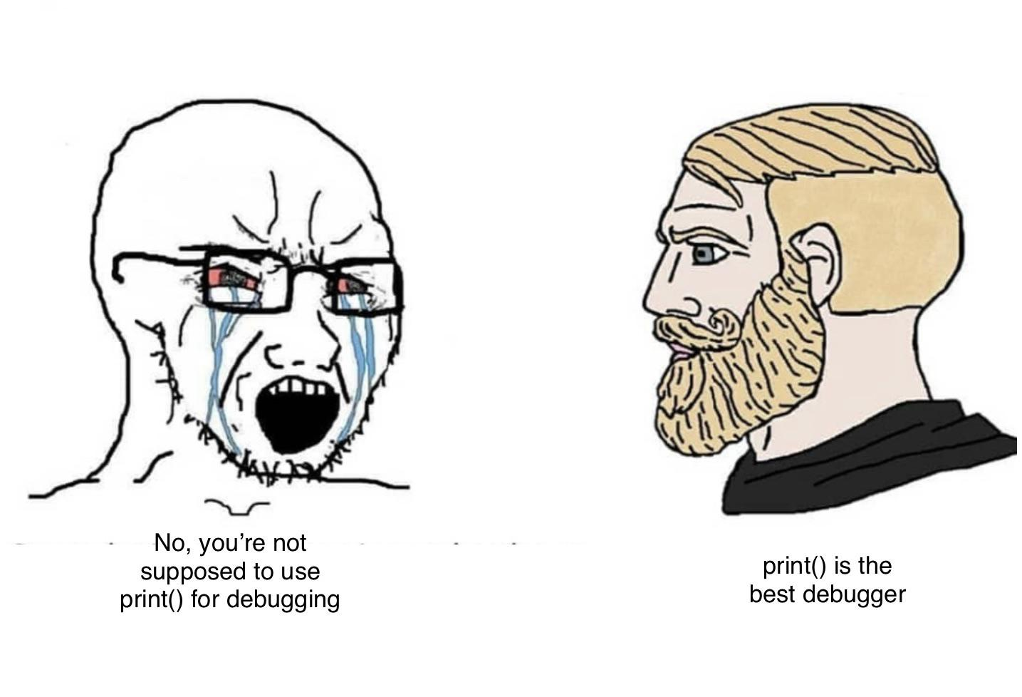
Print ain’t for debugging

Slide 28
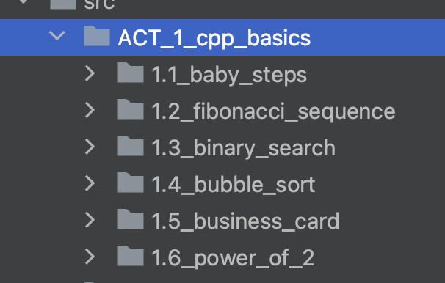
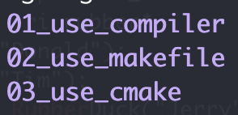
ACT I: Basics
Variable
Pointer, reference
Array
Control flow (loop, if)
Function
Branch: main
Branch: gcc_makefile_cmake_linux

Slide 29

Memory
Data
Memory (Storage)
Computer Memory
0
8
Data
Memory Address
16
32
… …

Slide 30
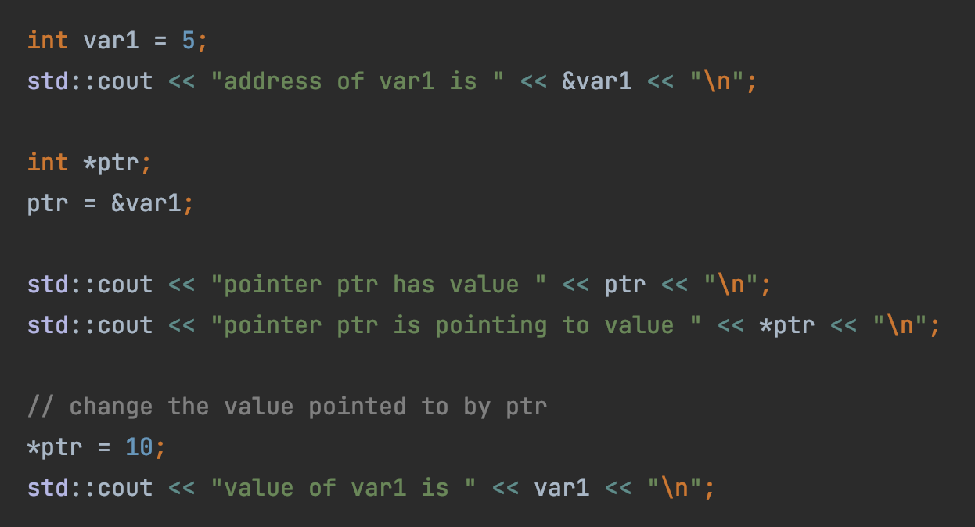

Pointer
Hexadecimal Address
0x0
1 byte (8 bits)
0x8
0x10
0x18
Var1 (5)
sizeof(int)
4 bytes
… …
ptr (0x18)
sizeof(int*)
8 bytes

Slide 31
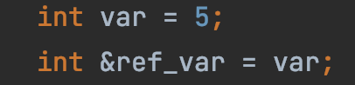
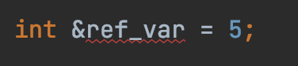
Reference
Hexadecimal Address
0x0
1 byte (8 bits)
0x8
0x10
0x18
Reference: a label (new name) to an existing variable
… …
Var1 (5)
ref_var
What’s wrong with this?

Slide 32

Binary Search
Target: 14
1
3
5
7
9
10
12
12
14
14
18

Slide 33
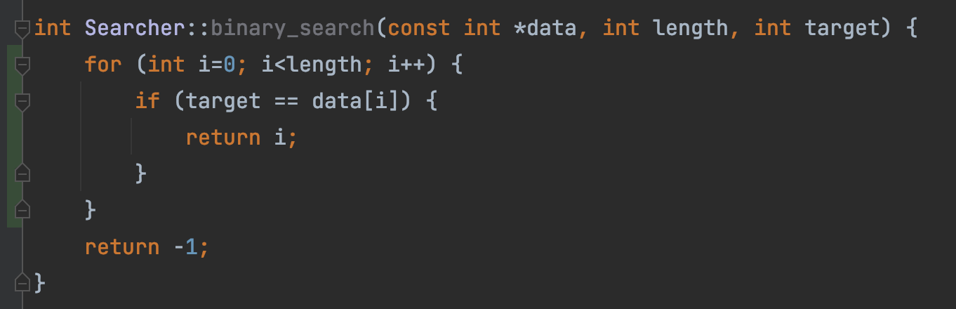
This is linear search, not binary search
“But test passed!”
Test passed
➔ ?
Code is correct
Test failed
➔ ?
Code is wrong

Slide 34
Bubble Sort
9
1
8
7
3
1
9
8
7
3
Round 1
1
8
9
7
3
1
8
7
9
3
1
8
7
3
9

Slide 35
1
8
7
3
9
1
8
7
3
9
Round 2
1
7
8
3
9
1
7
3
8
9

Slide 36
1
7
3
8
9
Round 3
1
7
3
8
9
1
3
7
8
9

Slide 37
1
3
7
8
9
Round 4
1
3
7
8
9

Slide 38
1
3
7
8
9
Round 5
1
3
7
8
9

Slide 39
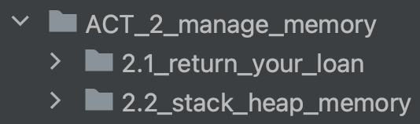
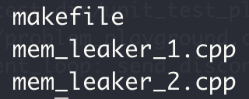
ACT II: Memory Management
Heap vs stack memory
new & delete
Memory leak
Bad reference
Branch: main
Branch: gcc_makefile_cmake_linux

Slide 40
Stack vs Heap
0x0
1 byte (8 bits)
0x8
Not automatically free/returned to OS
0x10
Heap
0x18
new operator
malloc
… …
Automatically free/returned to OS
Stack
function local variables

Slide 41
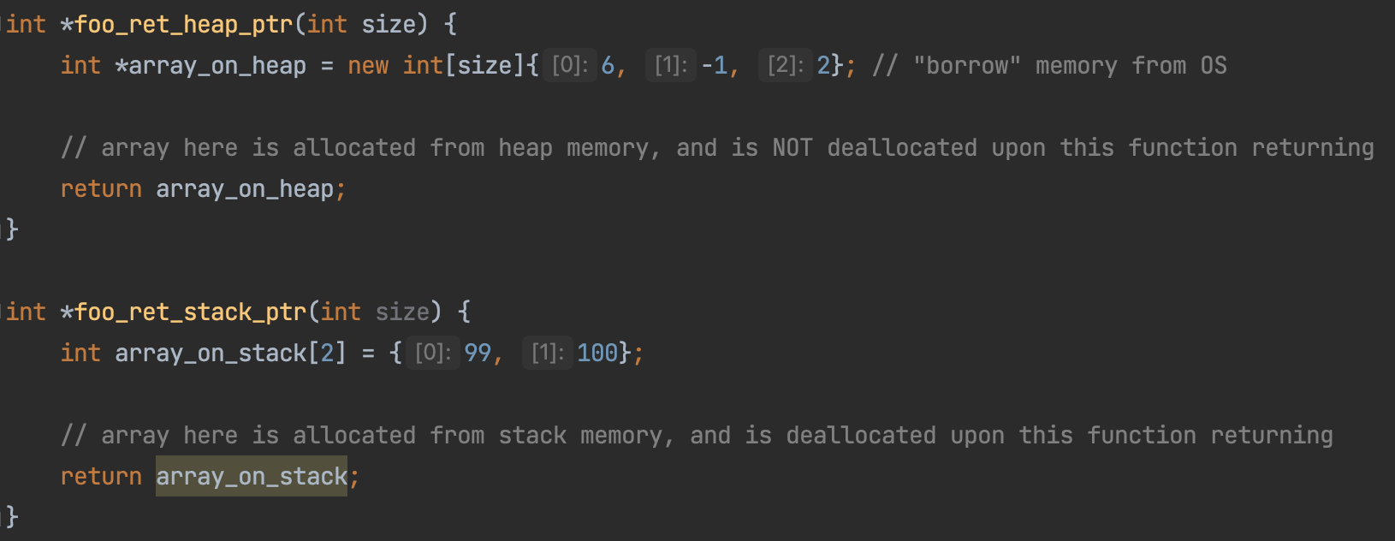
Stack vs Heap
0x0
1 byte (8 bits)
0x8
0x10
Heap
0x18
… …
Stack

Slide 42
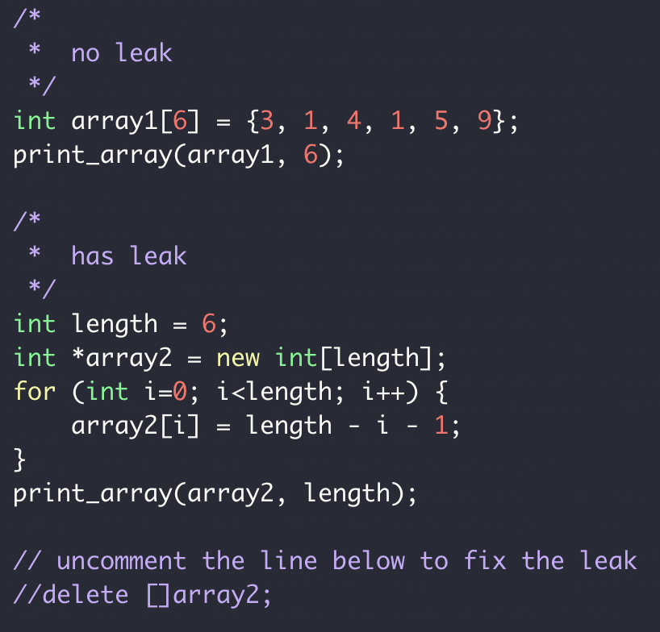
Memory Leak
0x0
1 byte (8 bits)
0x8
0x10
Heap
0x18
… …
Stack

Slide 43
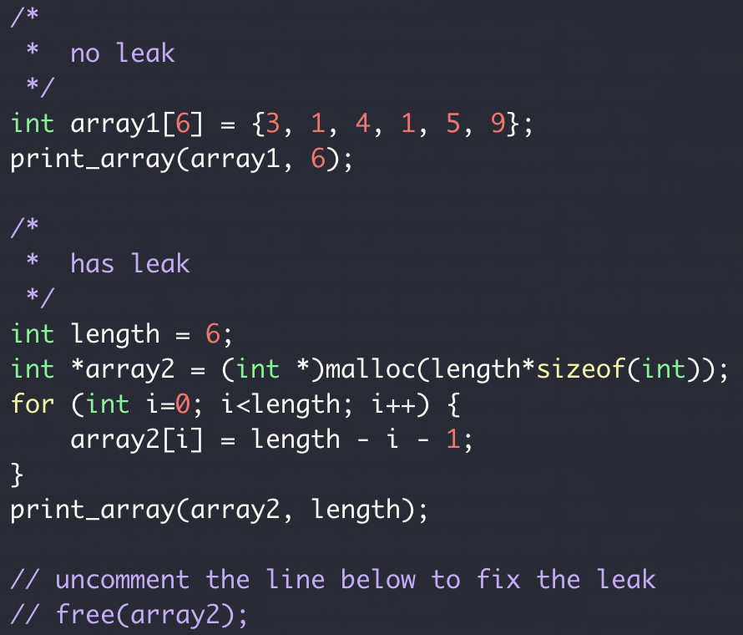
Memory Leak
0x0
1 byte (8 bits)
0x8
0x10
Heap
0x18
… …
Stack

Slide 44
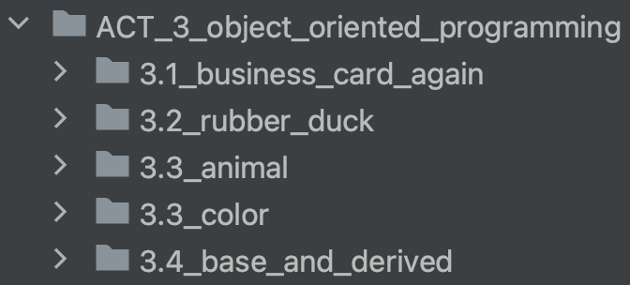
ACT III: Object Oriented Programming
class
Object/instance
Inheritance
Metamorphism
Branch: main

Slide 45
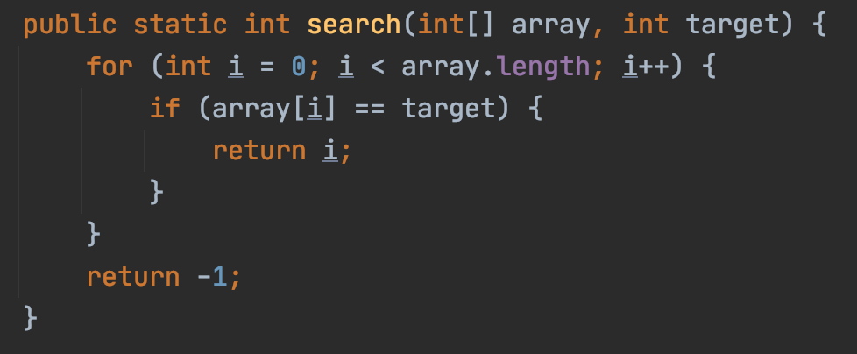
Object Orient Programming
Functional
OOP

Slide 46

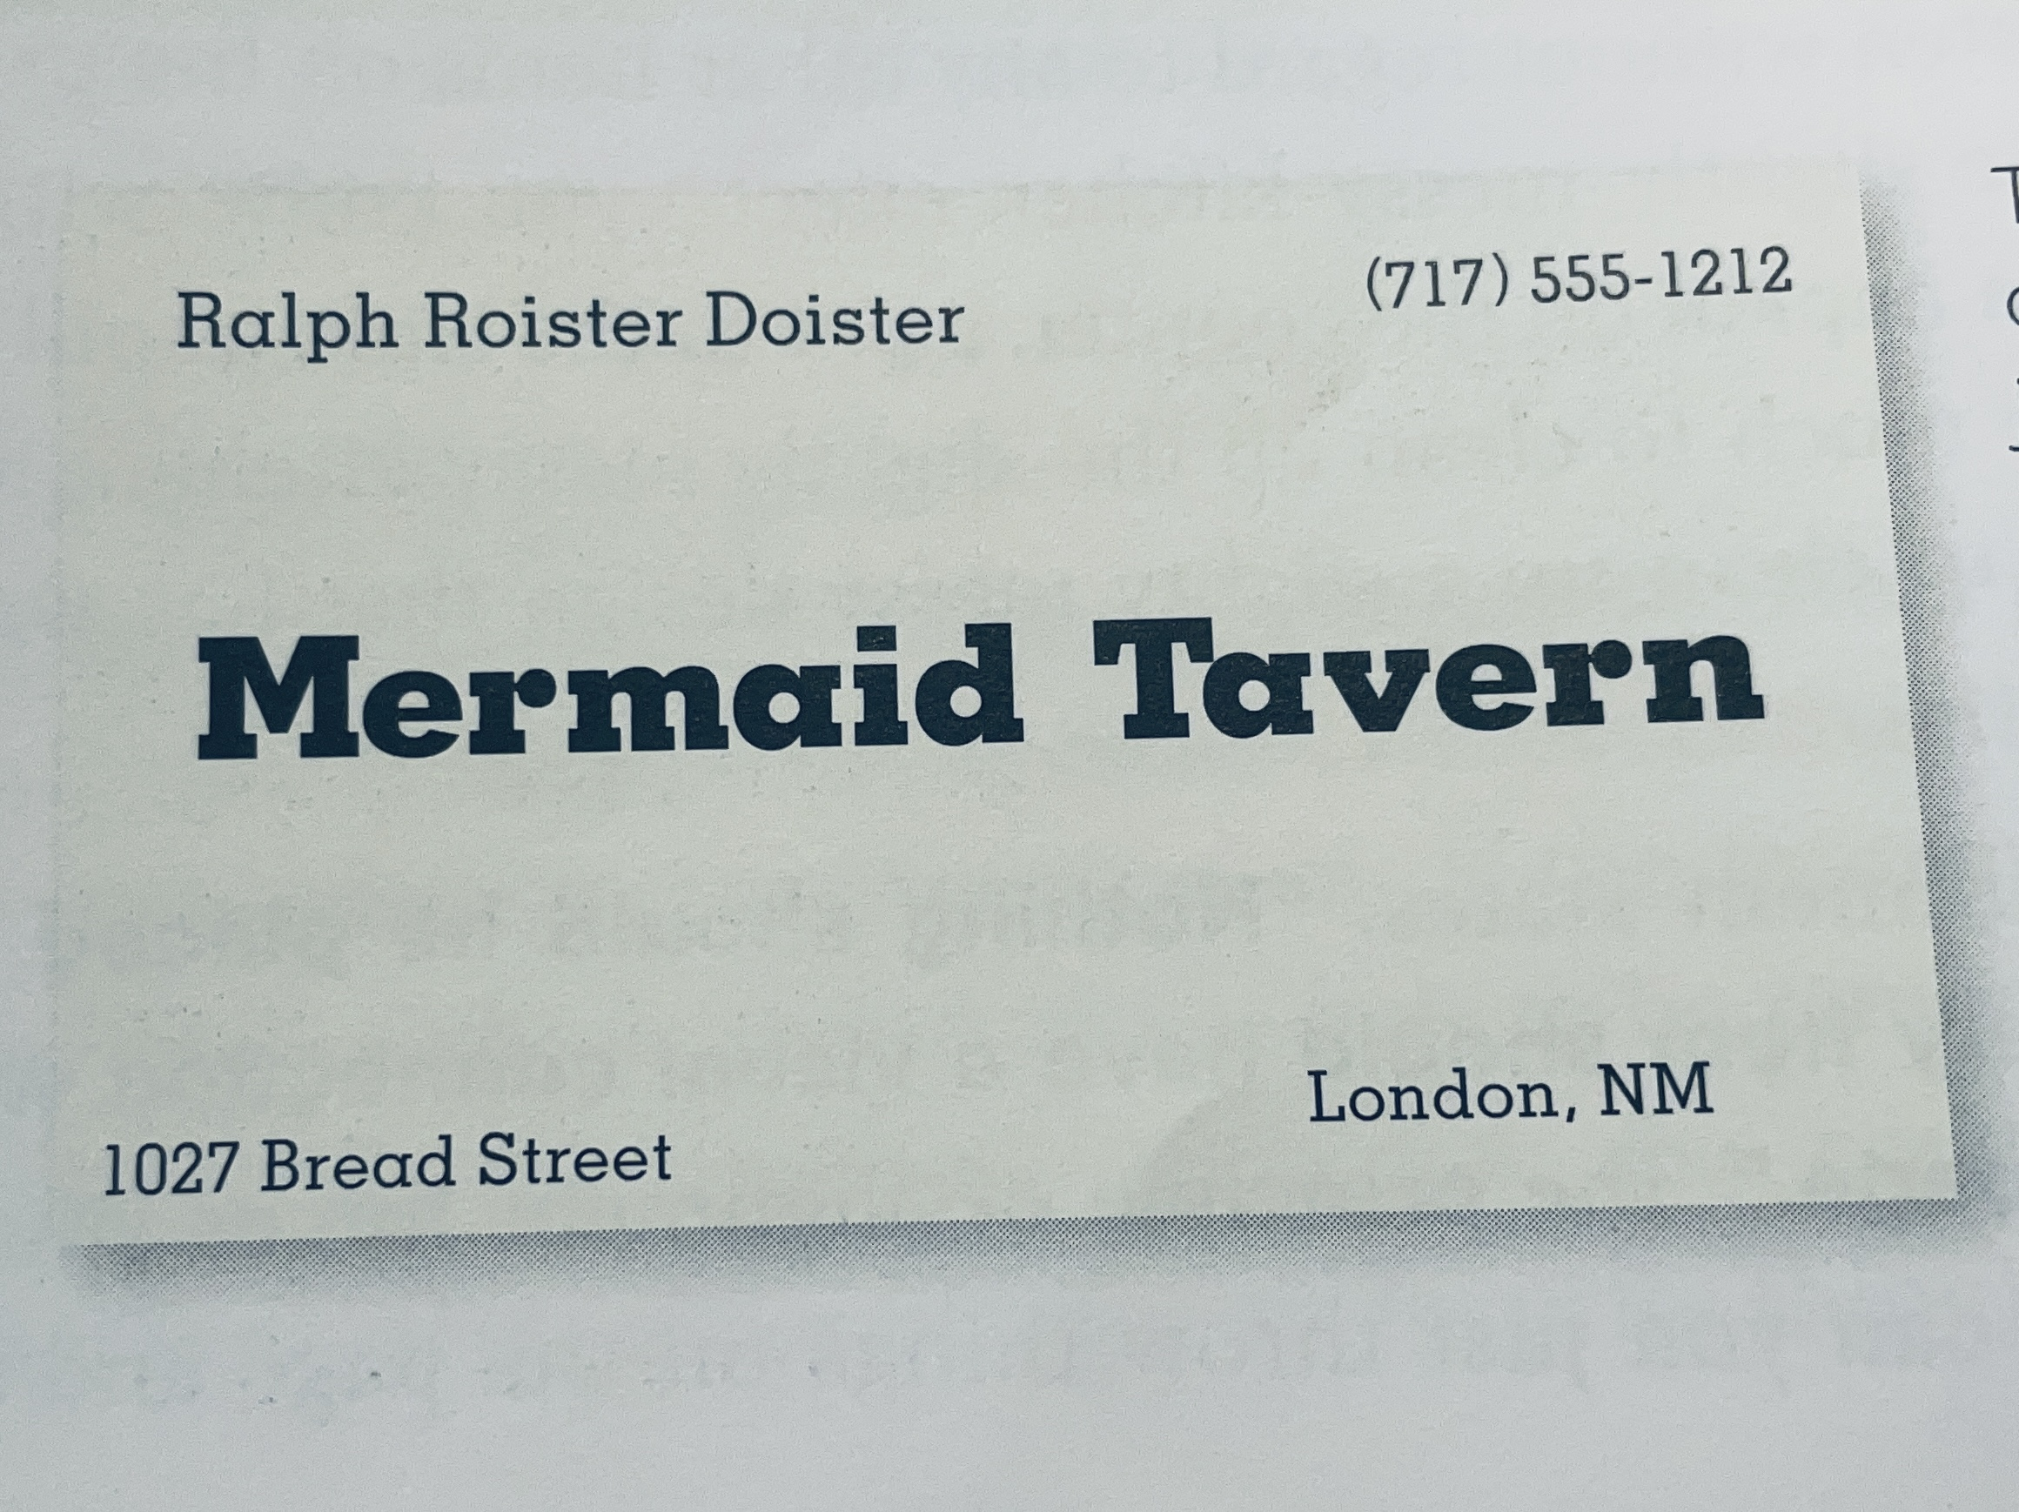
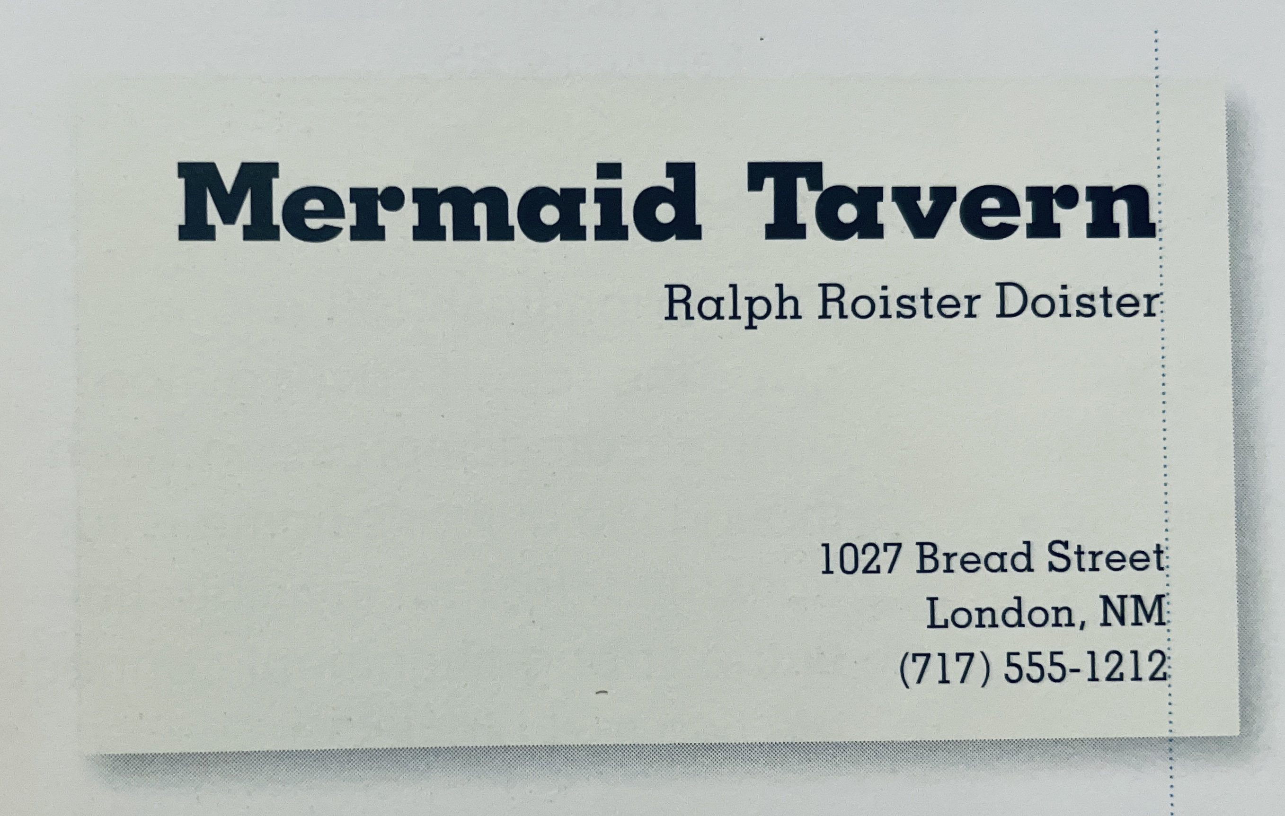
Why Object Oriented?
What’s the design issue with this business card?
Group related information together

Slide 47
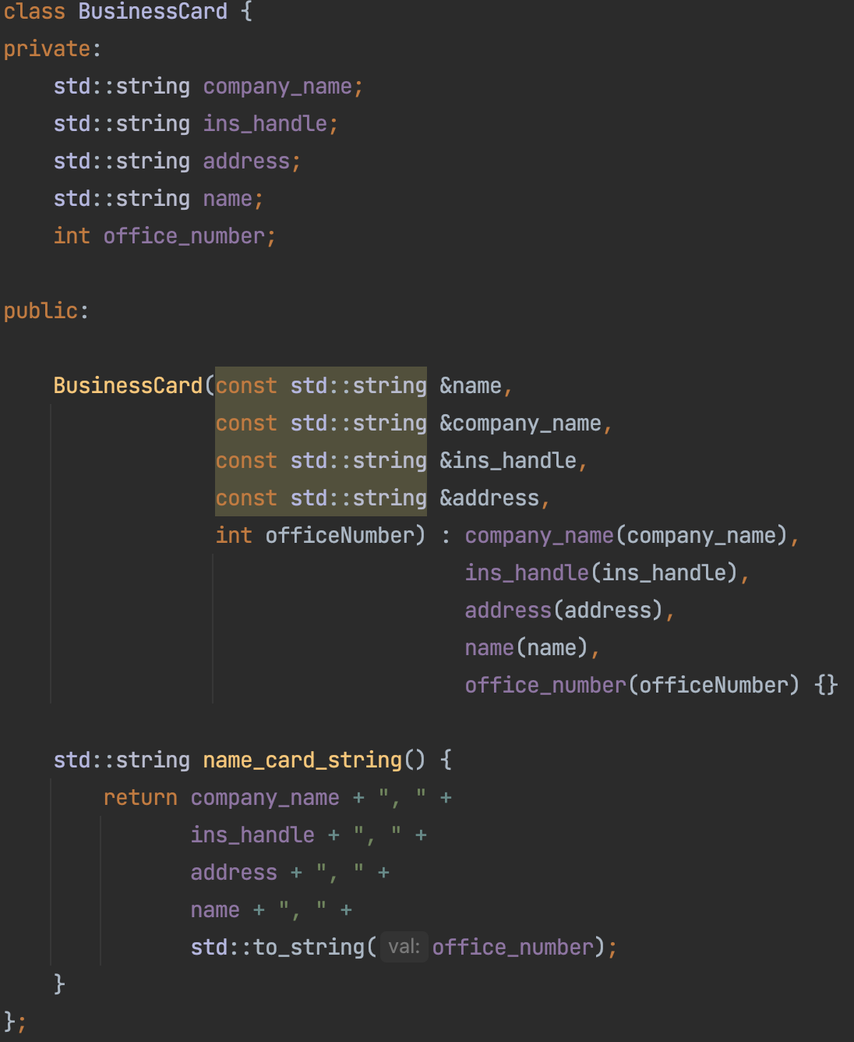
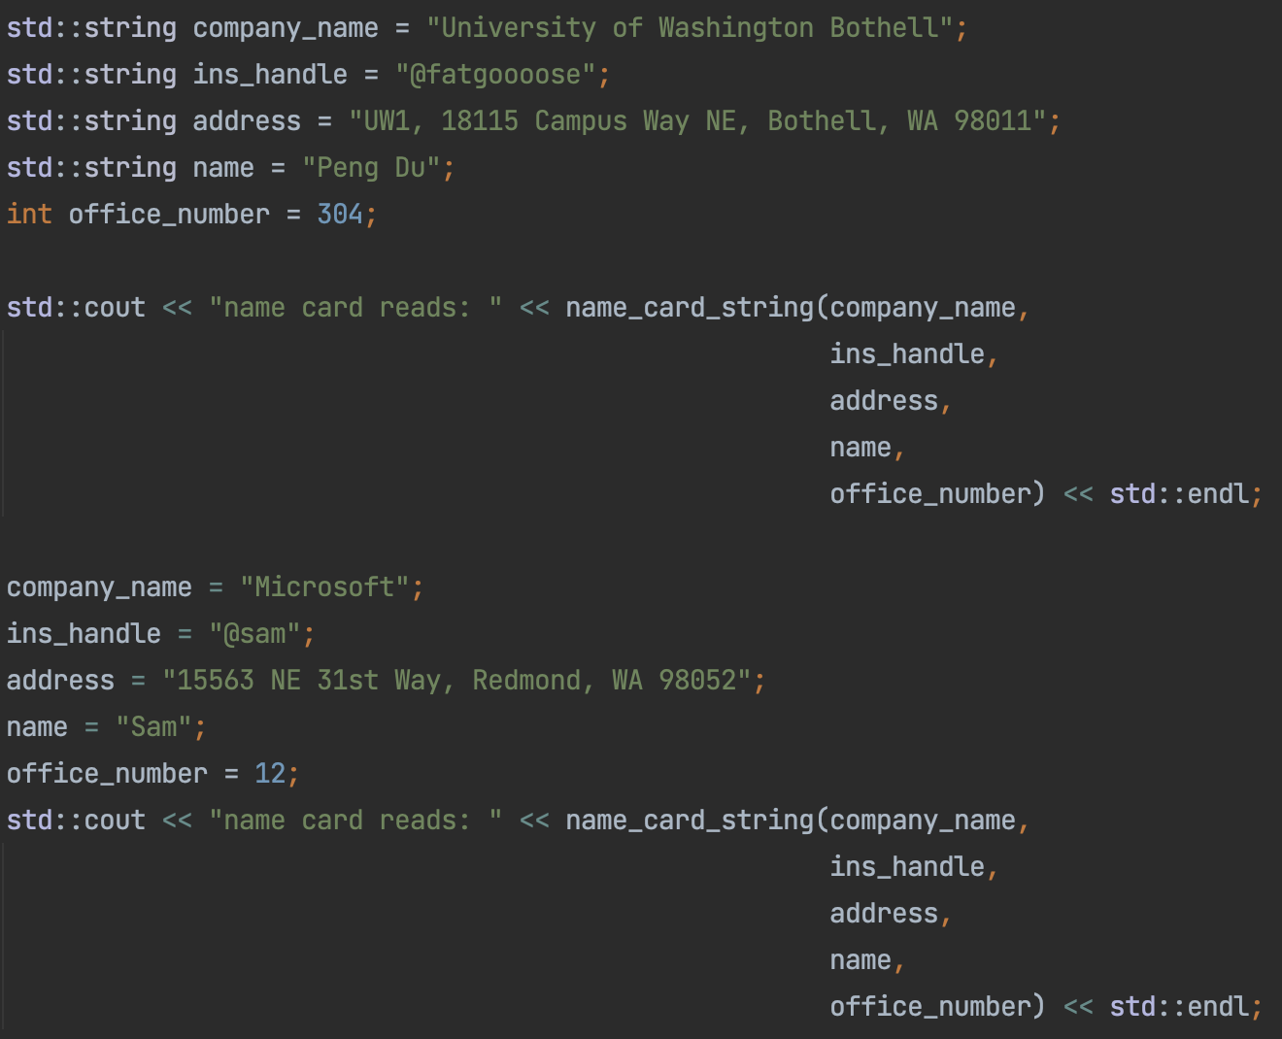
Why Object Oriented?
OOP: Group related information together

Slide 48
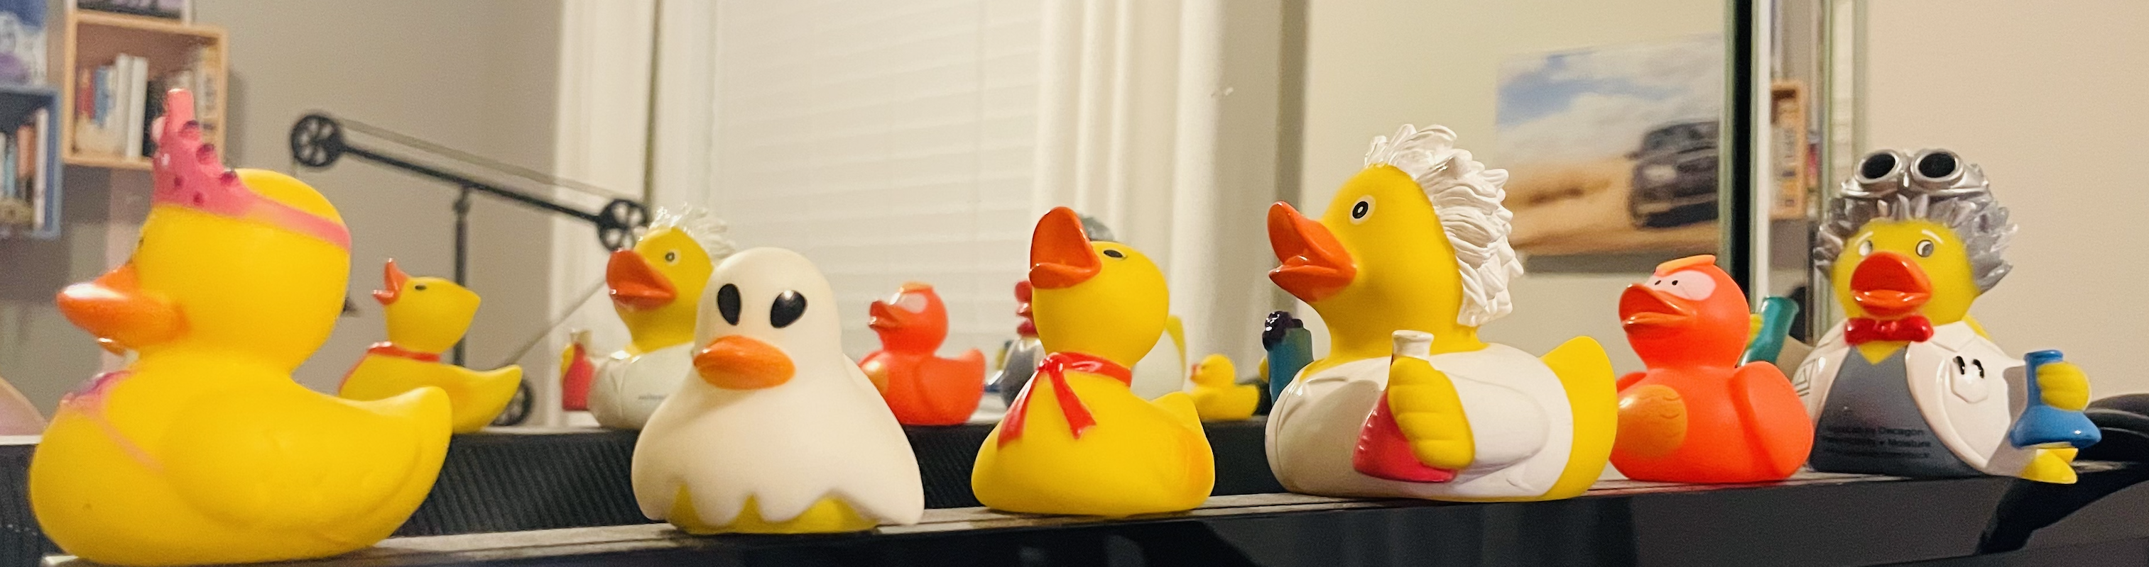

Class vs Object vs Instance
Class：
A “kind” of thing
Object：
Concrete Object
“Rubber Duck”

Slide 49
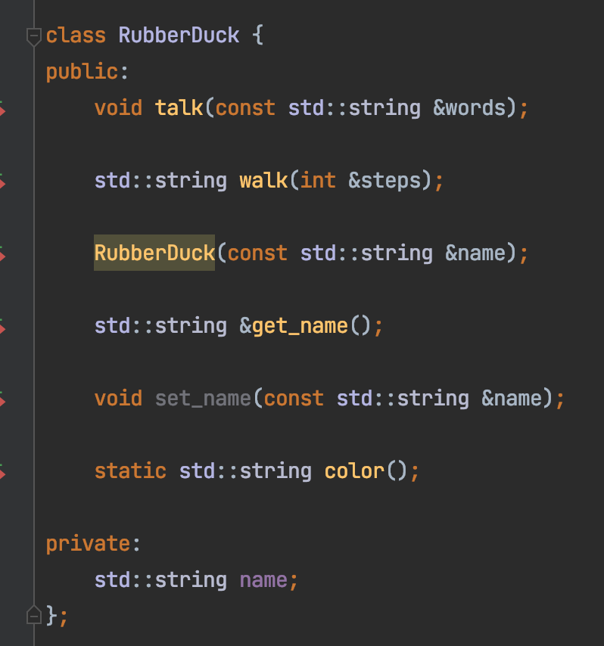
Class
Member Variables:
Name
Member Methods:
walk
talk

Slide 50
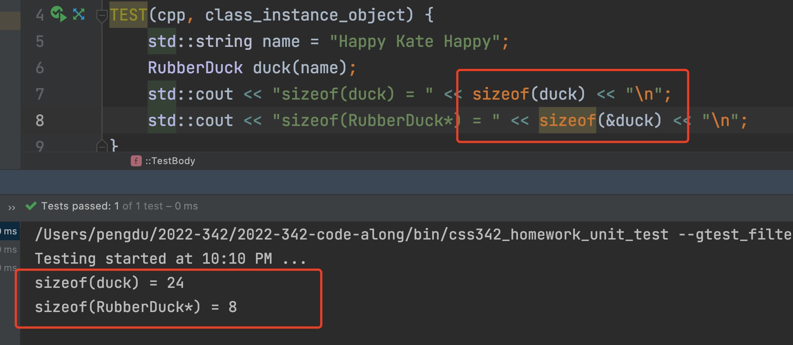
Class Instance
Hexadecimal Address
0x0
1 byte (8 bits)
0x8
0x10
0x18
… …
duck
sizeof(int*)
24 bytes

Slide 51

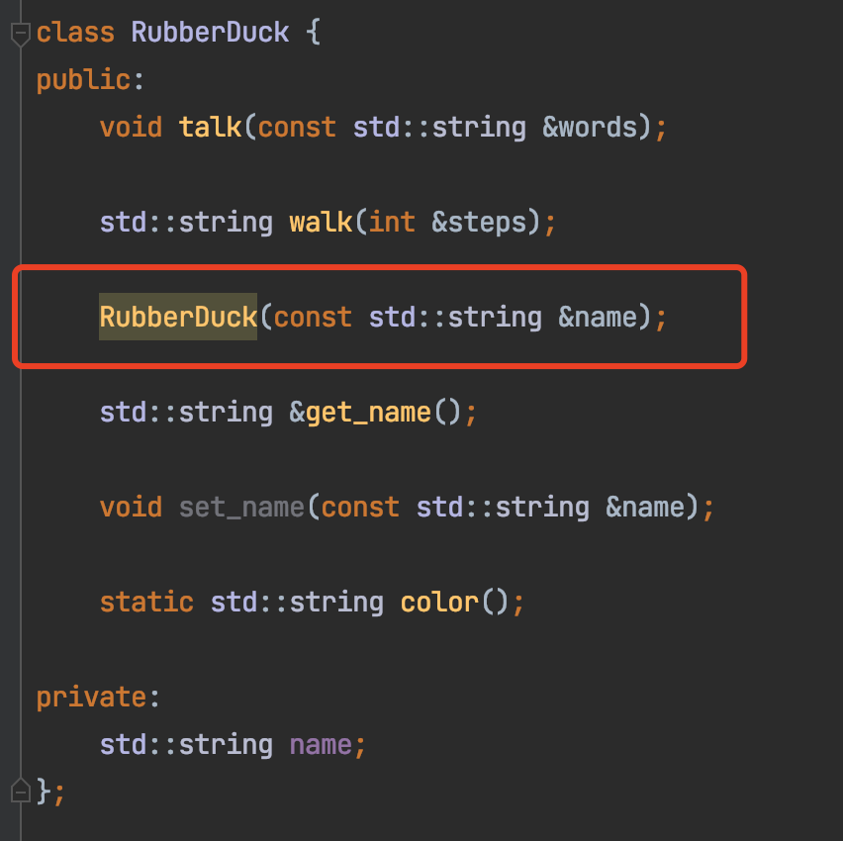
Constructor
Code here

Slide 52
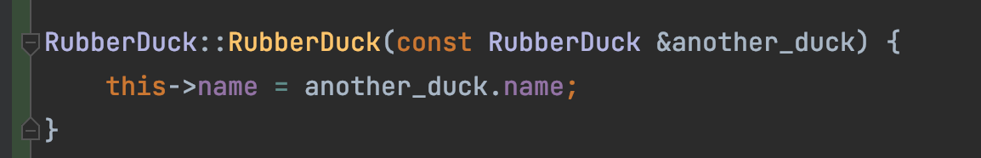
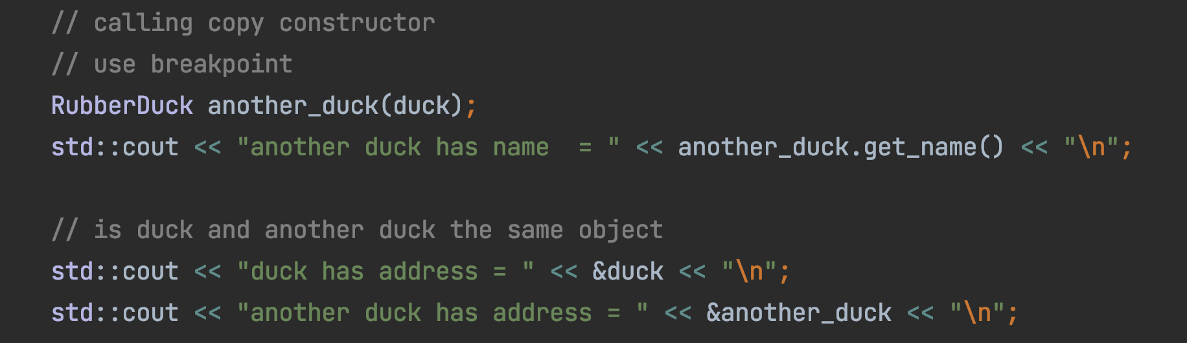
Copy Constructor
copy

Slide 53
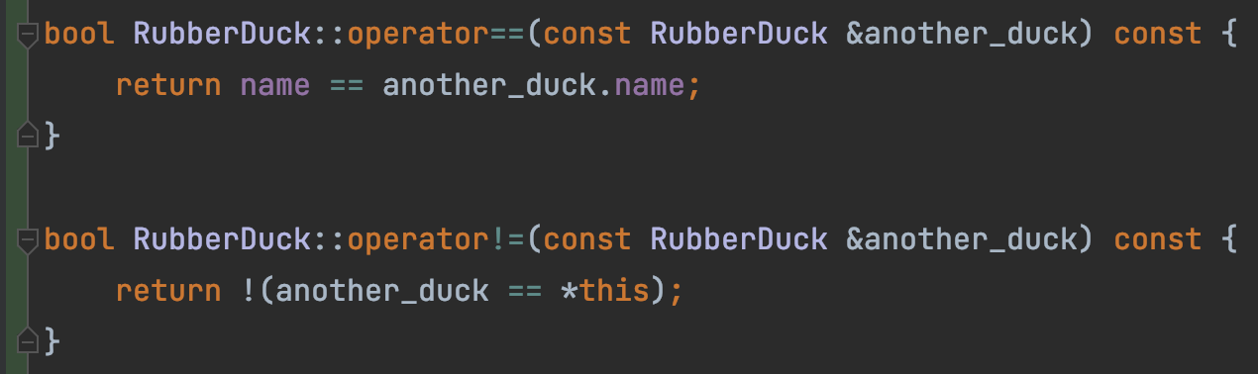
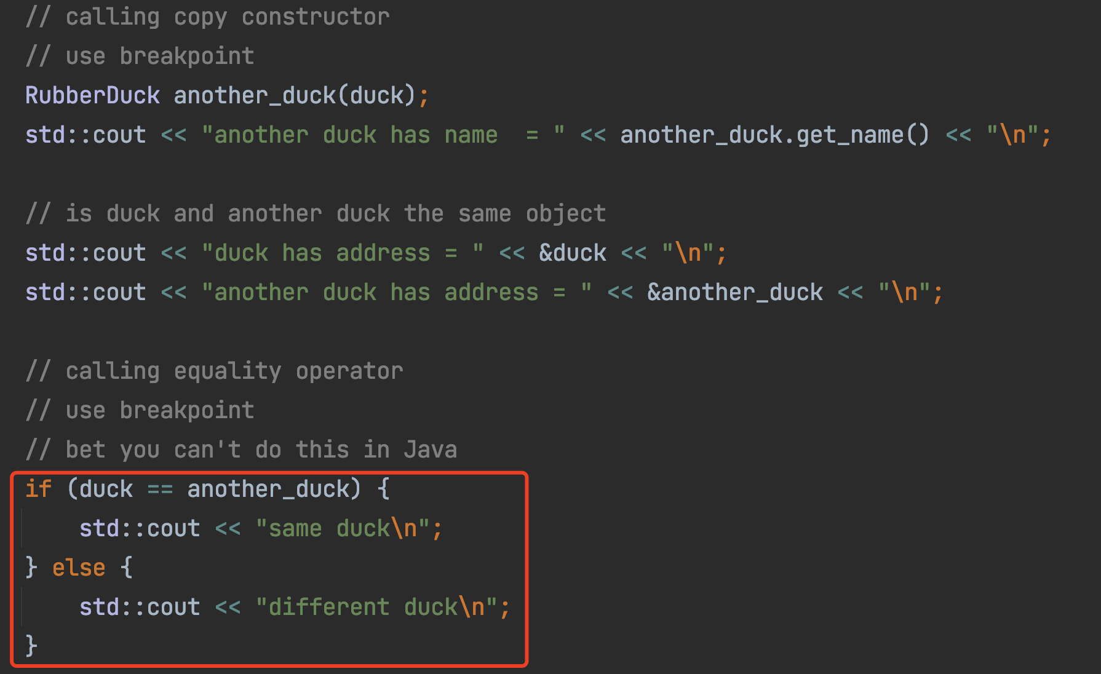
Operator Overload (==, !=)

Slide 54
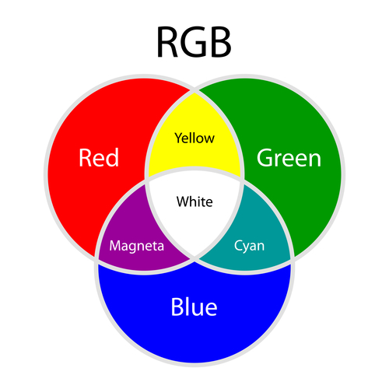
Operator Overload (+)
Red + Green = Yellow
Red + Blue = Magenta
Green + Blue = Cyan

Slide 55
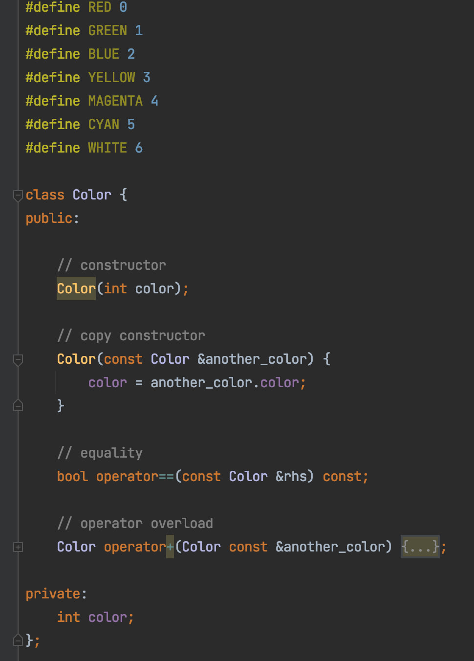
Operator Overload (+)
Code here

Slide 56
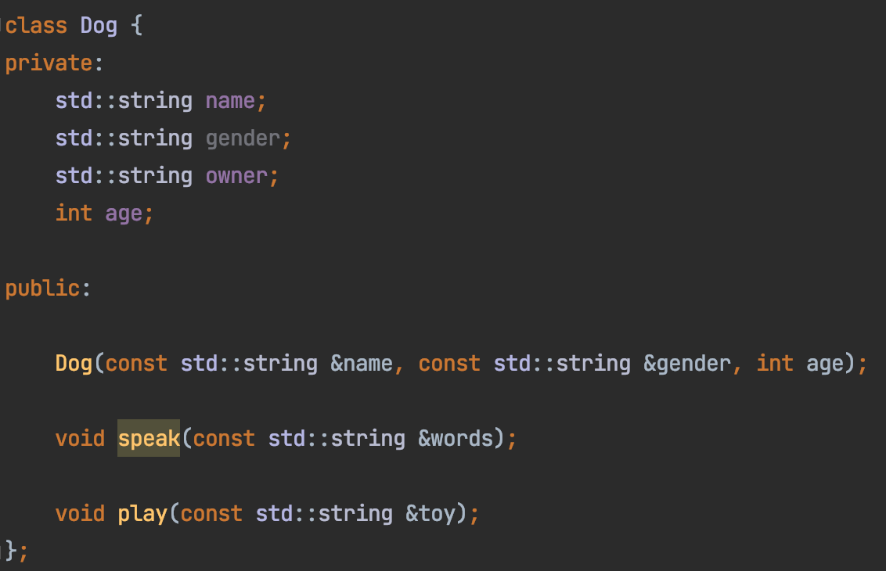
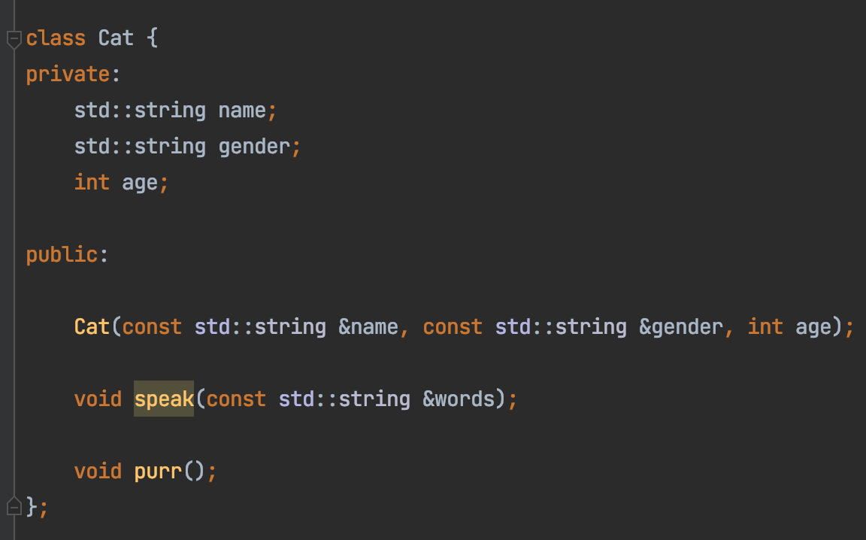
Inheritance
Compare the Cat and Dog class
Mostly Duplicated

Slide 57
Inheritance
Animal Class
Name
Gender
Age
Dog Class
Cat Class
Name
Gender
Age
Name
Gender
Age

Slide 58
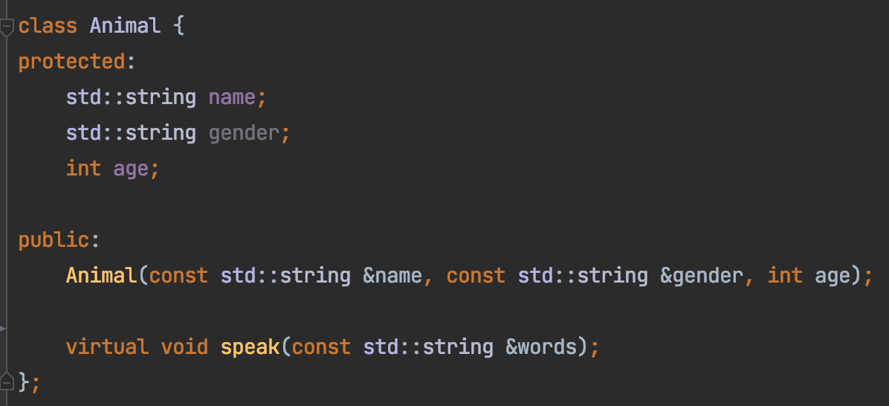
Inheritance
Animal Class
Name
Gender
Age
Base class constructor

Slide 59
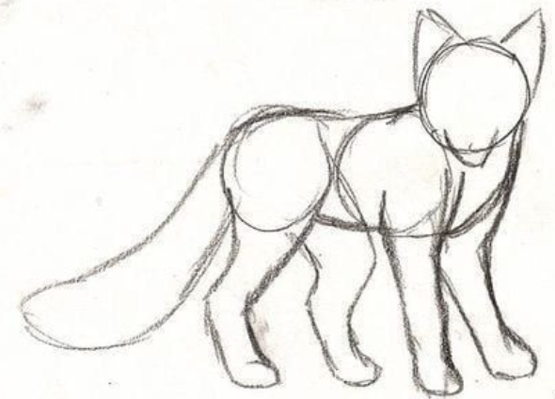
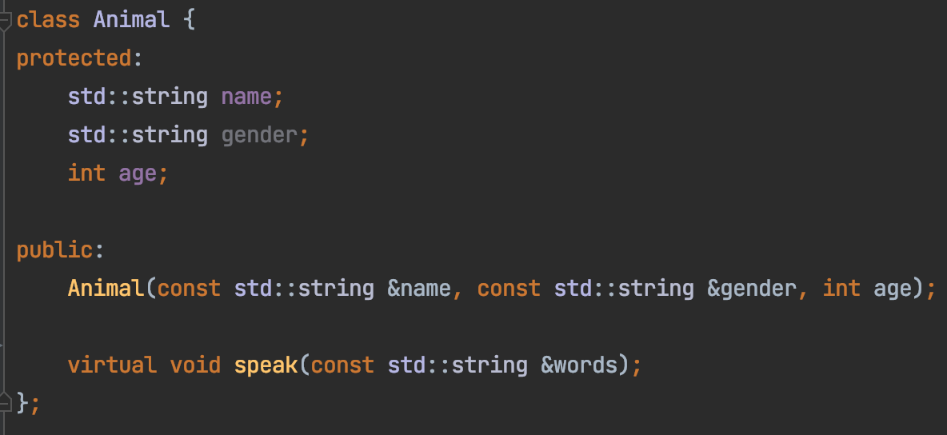
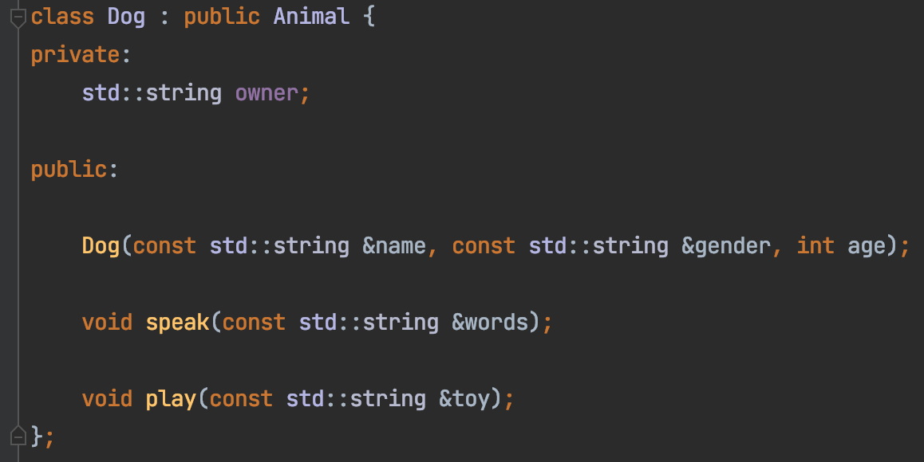

Inheritance

Slide 60
Constructor in A Derived Class
Calling base class constructor

Slide 61


Let all animals play
What if there’s 2000 different animals?

Slide 62

Let all animals play

Slide 63



Let all animals play

Slide 64


Let all animals play
Code here

Slide 65
Animal::speak() is NOT virtual
Derived Class
Cat cat;
Animal * p_cat = &cat;
Animal::speak()
Animal Class
p_cat -> speak()
Cat::speak()

Slide 66
Animal::speak() is virtual
Derived Class
Cat cat;
Animal * p_cat = &cat;
Animal::speak()
Animal Class
p_cat -> speak()
Cat::speak()

Slide 67
Virtual Function Demo
Code here
Base Class
Derived Class
int *base_class_data
Base Class
int capacity
int capacity
get_capacity()
get_capacity()
~BaseClass()
~BaseClass()
Inheritance
int *derived_class_data
get_capacity()
~DerivedClass()

Slide 68




Virtual Function Demo
Base Class
Derived Class

Slide 69


Virtual Function Demo
Derived destructor NOT called → Memory leak!

Slide 70




Virtual Function Demo
Derived class destructor called → Memory leak!

Slide 71
Agenda
Prelude: Tooling
Source code management
Build
Debug
ACT I: Basics
Variable
Pointer, reference
Array
Control flow (loop, if)
Function
ACT II: Memory Management
Heap vs stack memory
new & delete
Memory leak
Bad reference
ACT III: Object Oriented Programming
class
Object/instance
Inheritance
Metamorphism

Slide 72
Code
https://github.com/a-teaching-goose/2022-bootup
https://github.com/a-teaching-goose/2022-bootup#readme
Usage instruction
Two branches, one for IDE and one for command line

